Slide 1
Knee Evaluation

Slide 2
Objectives today:
Students will review terminology related to performing an injury evaluation, including HOPS.
Students will learn the process of combining HOPS with a full evaluation to come to a conclusion.
Students will be able to explain and perform special tests related to the knee.

Slide 3
Knee Evaluation
Think back to our Evaluation lessons…….
HOPS
History
Observation
Palpation
Special Tests

Slide 4
Knee Evaluation
History:
MAPPS;
Mechanism
Acute / Chronic
Previous Histories
Pain
Sounds

Slide 5
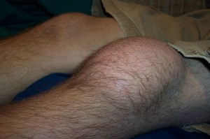
Knee Evaluation
Observation
Swelling
Ecchymosis
Scars
Wounds
Abnormalities

Slide 6
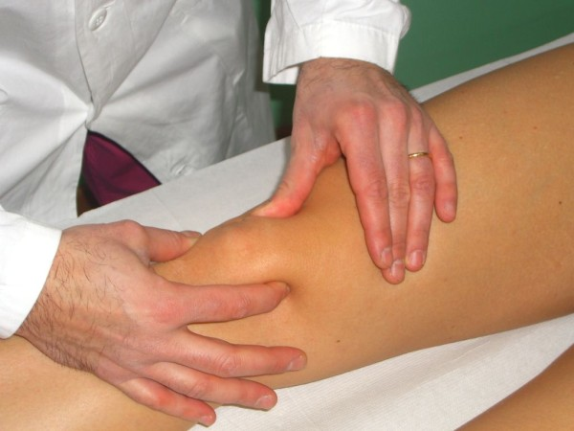
Knee Evaluation
Palpation

Slide 7
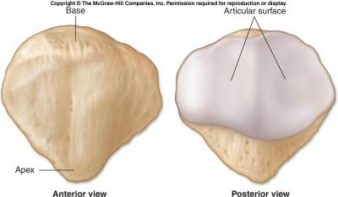
Knee Evaluation
Palpation – Inferior Angle /and Patella

Slide 8
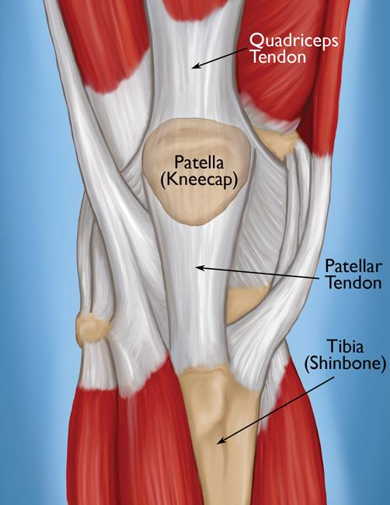
Knee Evaluation
Palpation – Patellar Tendon

Slide 9
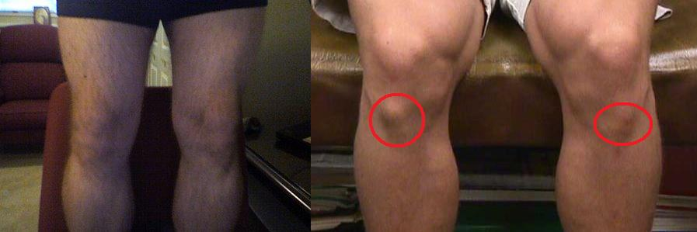
Knee Evaluation
Palpation – Tibial Tuberosity

Slide 10
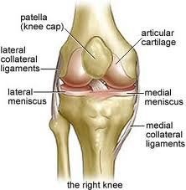
Knee Evaluation
Palpation – Medial & Lateral Joint Line

Slide 11
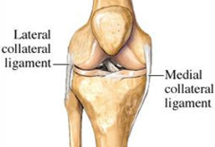
Knee Evaluation
Palpation – MCL & LCL

Slide 12
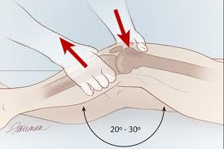
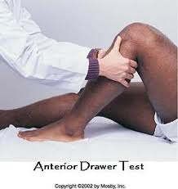
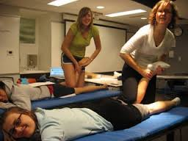
Knee Evaluation Special Tests
Leg Length
ROM/MMT
Valgus Stress
Varus Stress
Lachman’s
Anterior Drawer
Posterior Drawer
Godfrey 90-90
McMurray’s
Apley’s Grind
Thessaly

Slide 13
Knee Evaluation
As we go through the rest of the slides,
We will stop and do hands on with our partners.

Slide 14
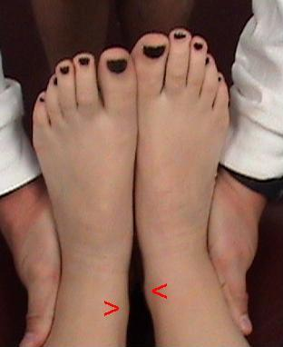
Knee Evaluation
Leg Length

Slide 15
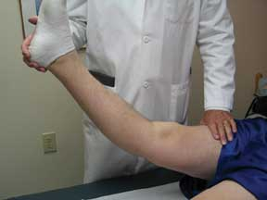
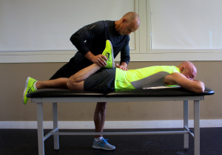
Knee Evaluation
ROM - Extension
ROM - Flexion

Slide 16
Knee Evaluation
Valgus Stress Test
Tests MCL
Use Valgus force
Distal end away from midline
Palpate MCL & Joint space
Feeling for laxity or pain

Slide 17
Knee Evaluation
Varus Stress Test
Tests LCL
Use Varus force
Distal end toward
the midline
Palpate LCL & Joint space
Feeling for laxity or pain

Slide 18
Knee Evaluation
Lachman’s
Tests ACL
Anterior glide of Tibia on Femur
Feeling for laxity or pain

Slide 19
Knee Evaluation
Anterior Drawer
Tests ACL
Start with your patient in a hook- lying position
Sit on their foot
Palpate the joint line
Tug the tibia forward
Feeling for laxity or pain

Slide 20
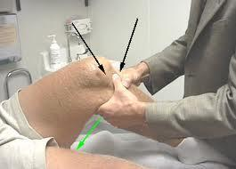
Knee Evaluation
Posterior Drawer Test
Tests PCL
Same position as Anterior Drawer
Push downward on the tibia
Feeling for laxity or pain

Slide 21
Knee Evaluation
Godfrey 90-90 Test
Start with your patient hook-lying
Observe the position of both tibias against the femur
Look for posterior sag & note your findings
Then lift both tibias to 90°
Observe the position of both tibias against the femur

Slide 22
Knee Evaluation
McMurray’s Test
Start with the leg extended
Hold the heel
Externally rotate the tibia
Palpate the joint line & apply varus stress while you flex the leg
At full flexion, internally rotate the tibia
Begin to extend & apply valgus stress

Slide 23
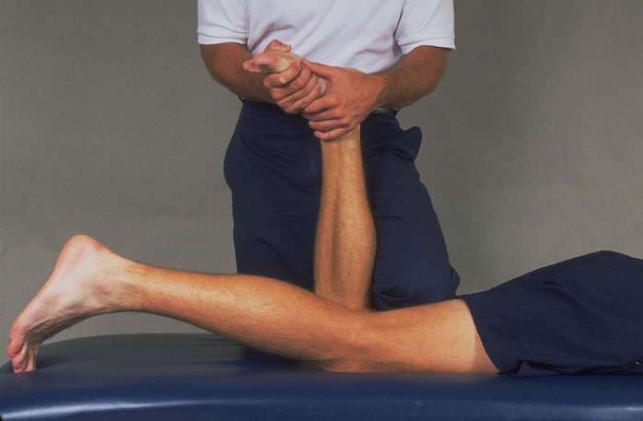
Knee Evaluation
Apley’s Grind
Your patient lies prone
Flex the knee to 90°
Apply compression to the tibia against the femur
Feel for pain or clicking
Then apply distraction to test for relief of the pain

Slide 24
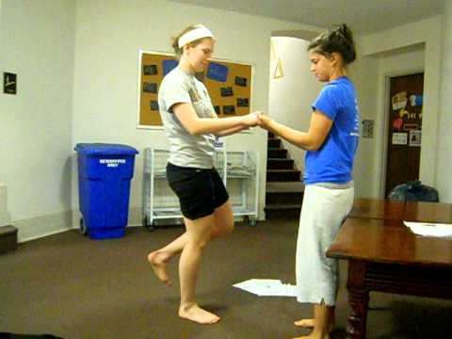
Knee Evaluation
Thessaly Test
Your patient will be standing in front of you
Squat on one leg about 15°
Have your patient twist from side to side
Ask for pain, popping or clicking in the knee
Test both sides!!

Slide 25
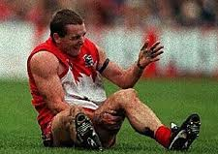
Patella Femoral Evaluation
Patella Dysfunction

Slide 26
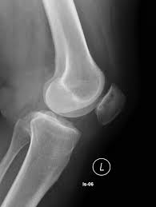
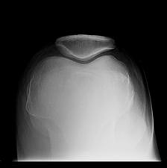
Patella Femoral Evaluation
Normal Patella

Slide 27
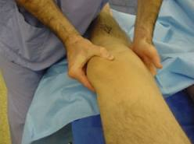
Patella Femoral Evaluation
Patellar Tracking

Slide 28
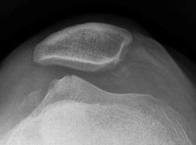
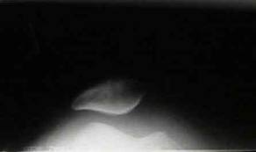
Patella Femoral Evaluation

Slide 29
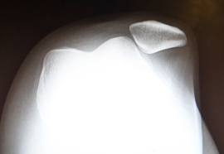
Patella Femoral Evaluation
Dislocated Patella

Slide 30
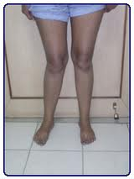
Patella Femoral Evaluation
Think about the angle of quad pull on the patella

Slide 31
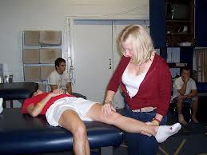
Knee Evaluation Let’s put it all together!
Patella Femoral Jt.
Patellar tracking
What conclusions did you find?
Palpation
Leg Length
ROM
Valgus Stress
Varus Stress
Lachman’s
Anterior Drawer
Posterior Drawer
Godfrey 90-90
McMurray’s
Apley’s

Slide 32
Patella Femoral Evaluation
The End!

